Slide 1
Cover your tracks

Slide 2
What is a digital fingerprint?
A digital fingerprint is essentially a list of characteristics that are unique to a single user, their browser, and their particular hardware setup. This includes information the browser needs to send to access websites, like the location of the website the user is requesting. But it also includes a host of seemingly insignificant data (like screen resolution and installed fonts) gathered by tracking scripts. Tracking sites can stitch all the small pieces together to form a unique picture, or "fingerprint," of your device.

Slide 3
Some defenses against fingerprinting
Using a Tracking Blocker
Install a tracker blocker and watch your browsing experience get a lot more pleasant
Most tracker blockers cross-reference massive lists of tracking scripts. They then block any attempts to load an ad or other item that matches.
When you block trackers, you prevent tracking companies from reading your browser fingerprint. However, more advanced tracking techniques may still be able to gather information about you.

Slide 4
Some defenses against fingerprinting
Disabling Javascript
Most trackers run on JavaScript, and they can’t gather much of the information used to determine your browser fingerprint without it. Thus, your browser looks a lot less distinct, and is more protected.
But there is a trade off. Disabling JavaScript breaks a staggering amount of websites, and limits the functionality of many more.

Slide 5
Some defenses against fingerprinting
Changing browser settings from defaults
Tracking is so pervasive that all of the major browsers (Chrome, Firefox, and Safari) come with settings that disable certain types of tracking. Turning them on or off is as simple as going into the settings menu and clicking a button.
Disabling tracking scripts in your browser settings is reliably effective, though not as robust as a designated tracker-blocker.
For more info about what settings and protections your browser offers compared to others, check out this article from Blacklight.

Slide 6
Some defenses against fingerprinting
Using a fingerprint resistant browser
Some newer browsers were built to thwart fingerprinting, such as Tor Browser and Brave. How they do this varies from browser to browser, but they generally work by making your fingerprint less unique and/or less consistent. This means trackers have a harder time following your usage of the web.

Slide 7
Some defenses against fingerprinting
Incognito mode
Historically, Private Browsing and Incognito Mode had a single purpose. These modes were intended to prevent traces of sites you visited from being stored on your machine. It was not meant to prevent remote sites or trackers from identifying and storing when you visit a site on their servers.
If you are using Firefox, using Private Browsing will provide some protections against trackers. Any trackers that are included in the Disconnect tracking protection list will be blocked. This keeps you safe from known trackers. Known fingerprinters and cryptominers which use your browser against you are also blocked. However, this will not prevent a new fingerprinter or tracker from identifying your browser and keeping tabs on it. In order to get this extra level of protection, your browser needs to have a fingerprint which is either:
so common that a tracker can't tell you apart from the crowd (as in Tor Browser), or
randomized so that a tracker can't tell it's you from one moment to the next (as in Brave browser).
Google's Chrome browser does not provide protection against trackers or fingerprinters in Incognito Mode.

Slide 8
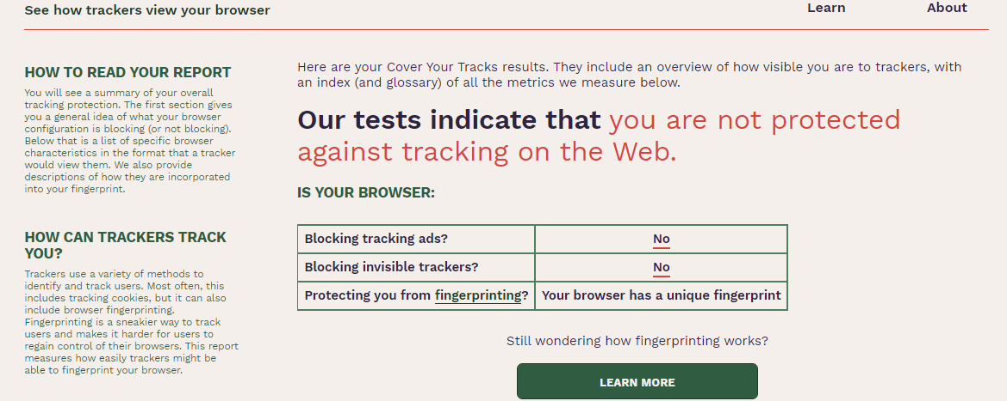
Chrome

Slide 9
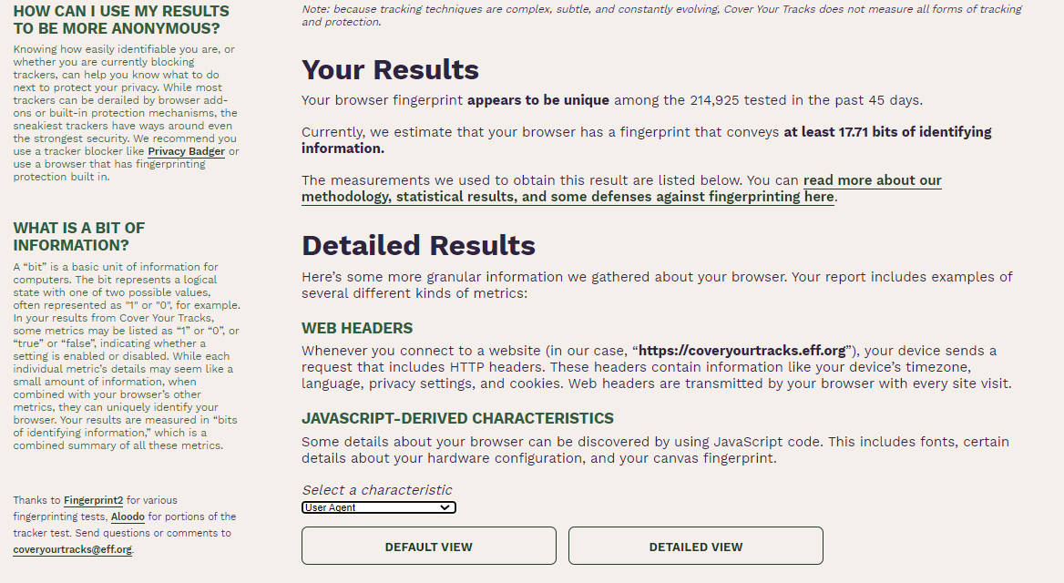

Slide 10
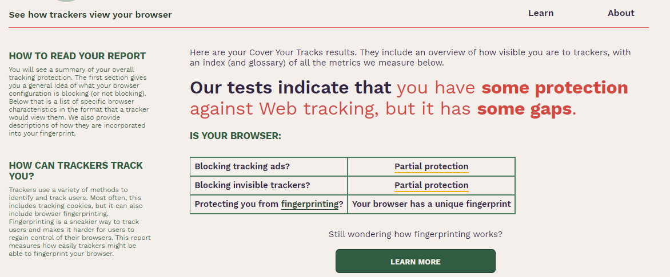
Chrome incognito mode

Slide 11
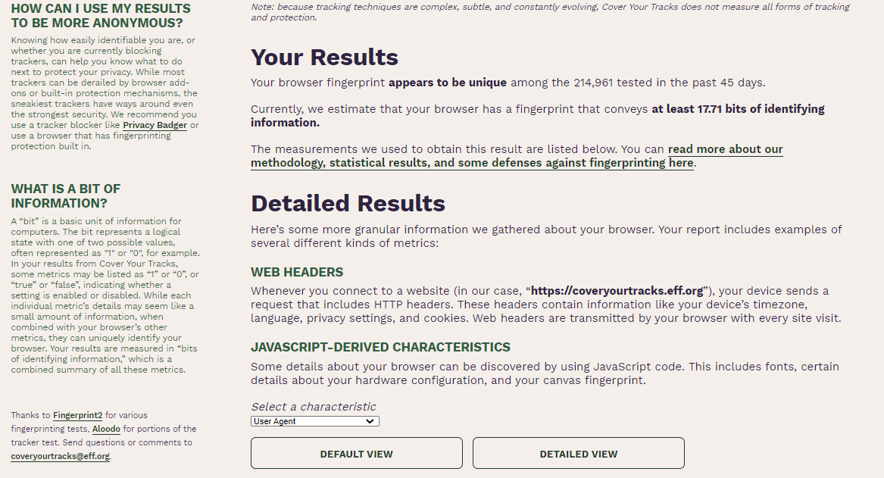

Slide 12
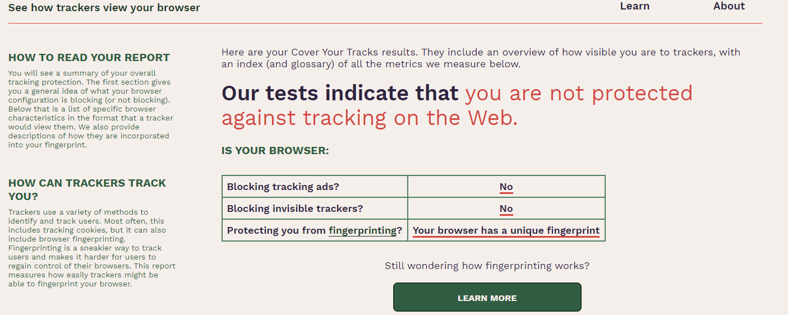
Microsoft Edge

Slide 13
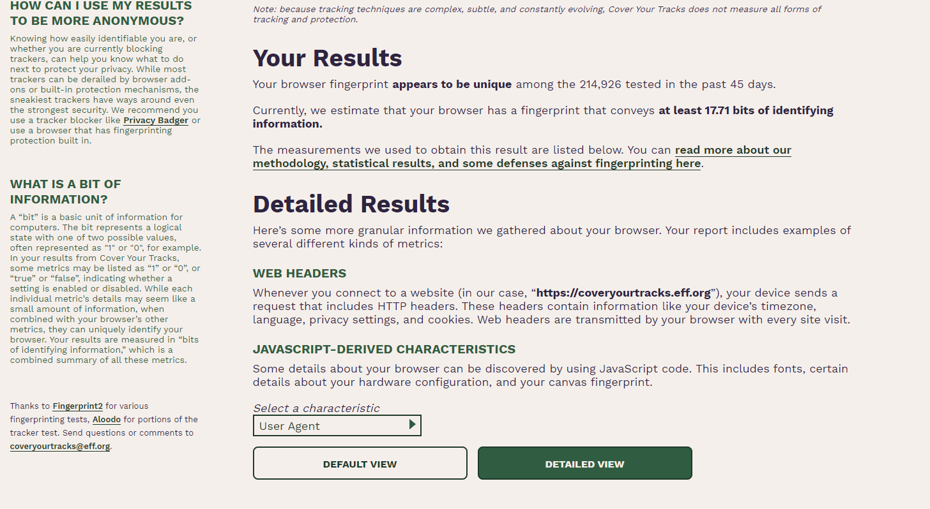

Slide 14
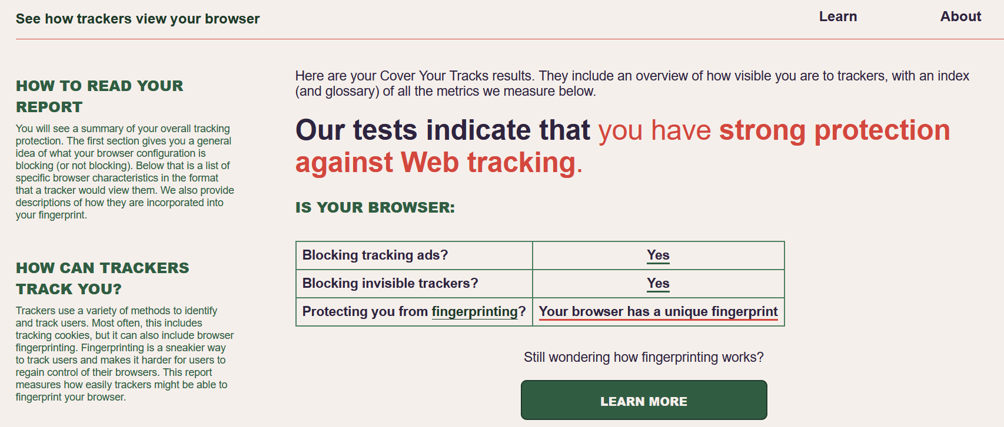
Mozilla Firefox

Slide 15
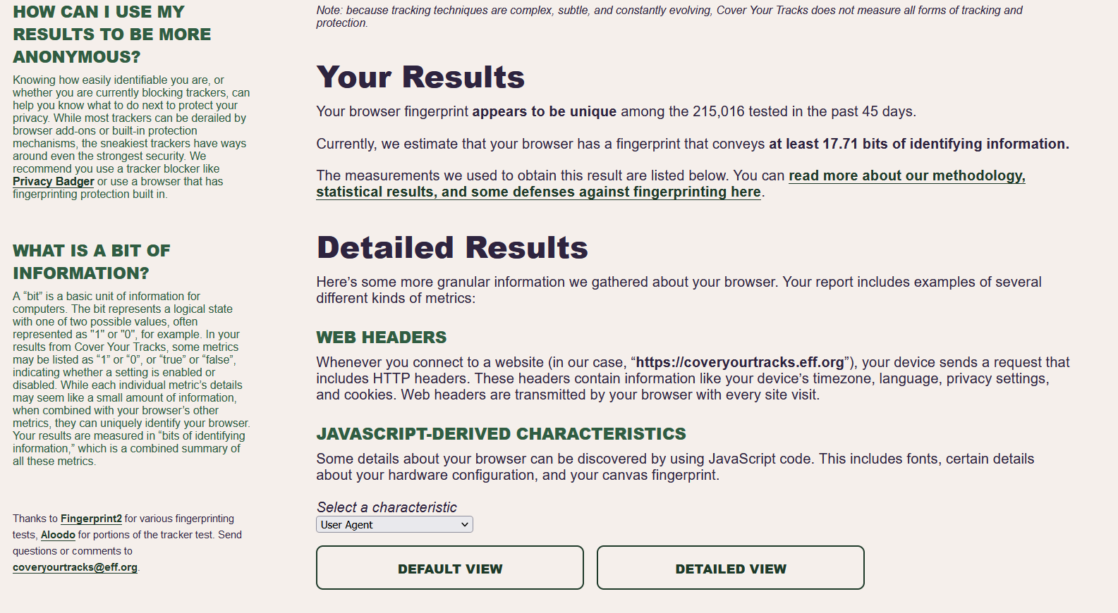

Slide 16
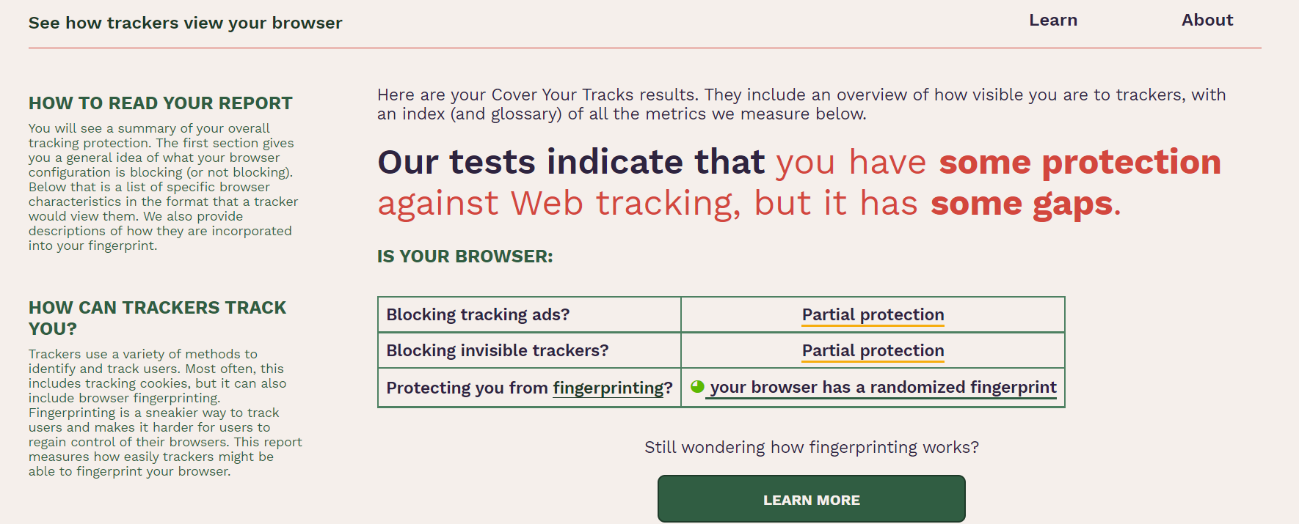
Brave
Brave

Slide 17
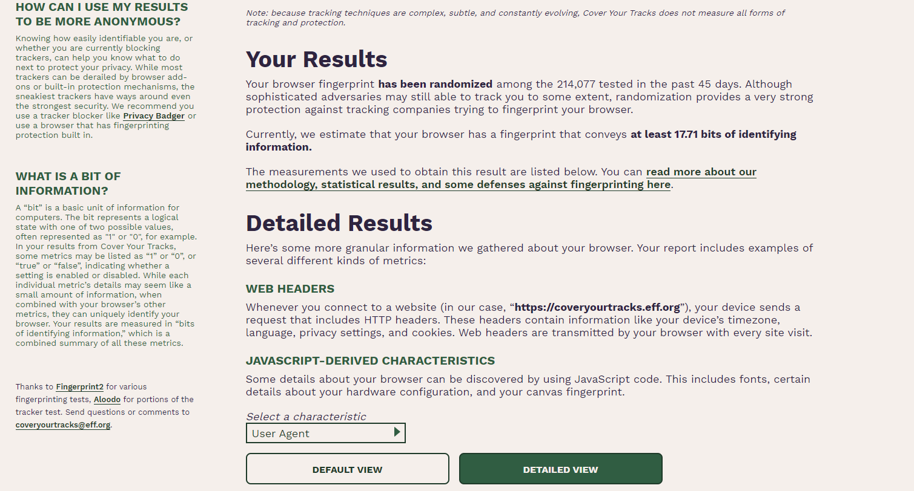

Slide 18
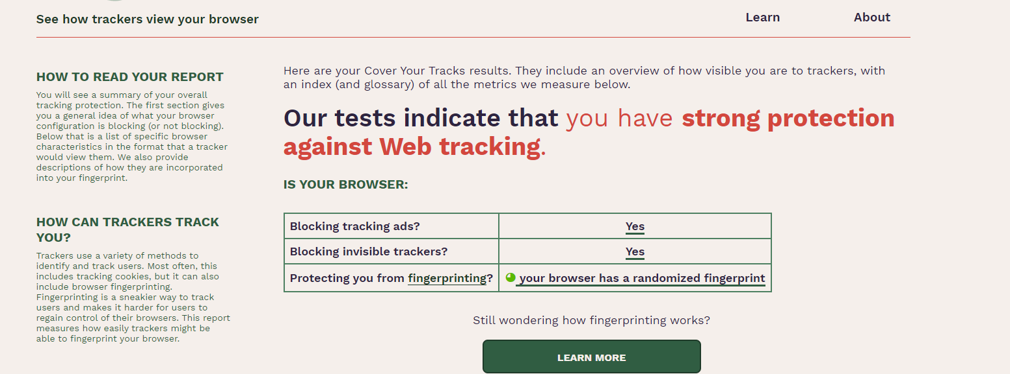
Brave with Tor Private tab

Slide 19
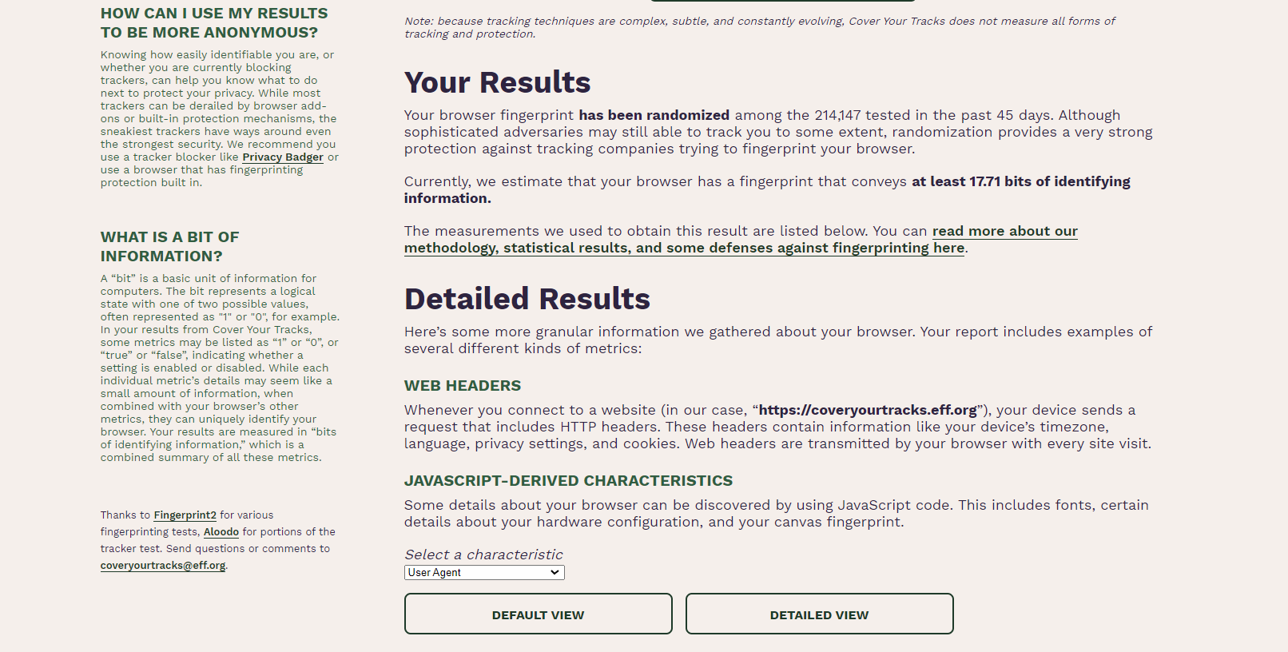

Slide 20
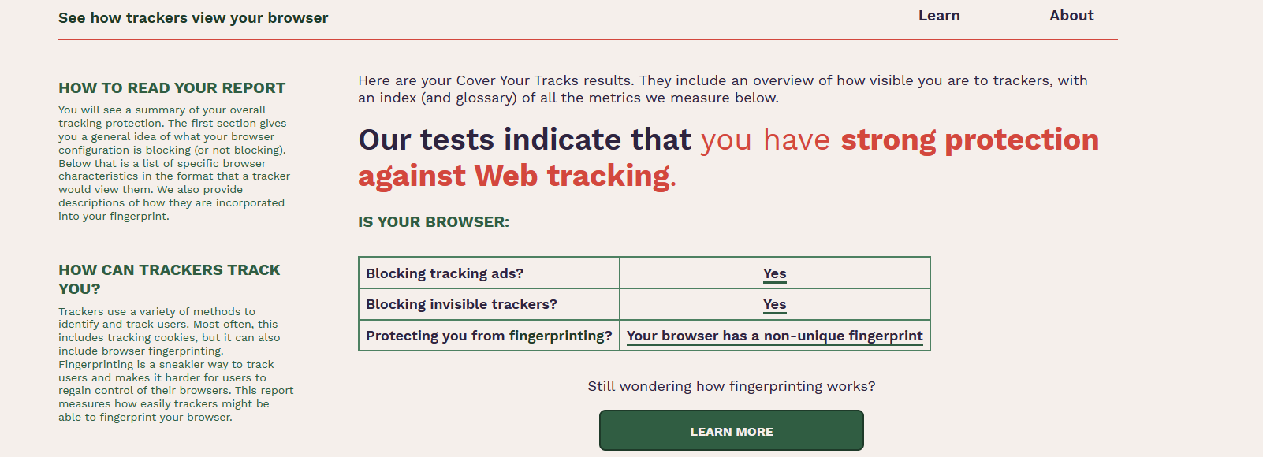
Tor with standard security

Slide 21
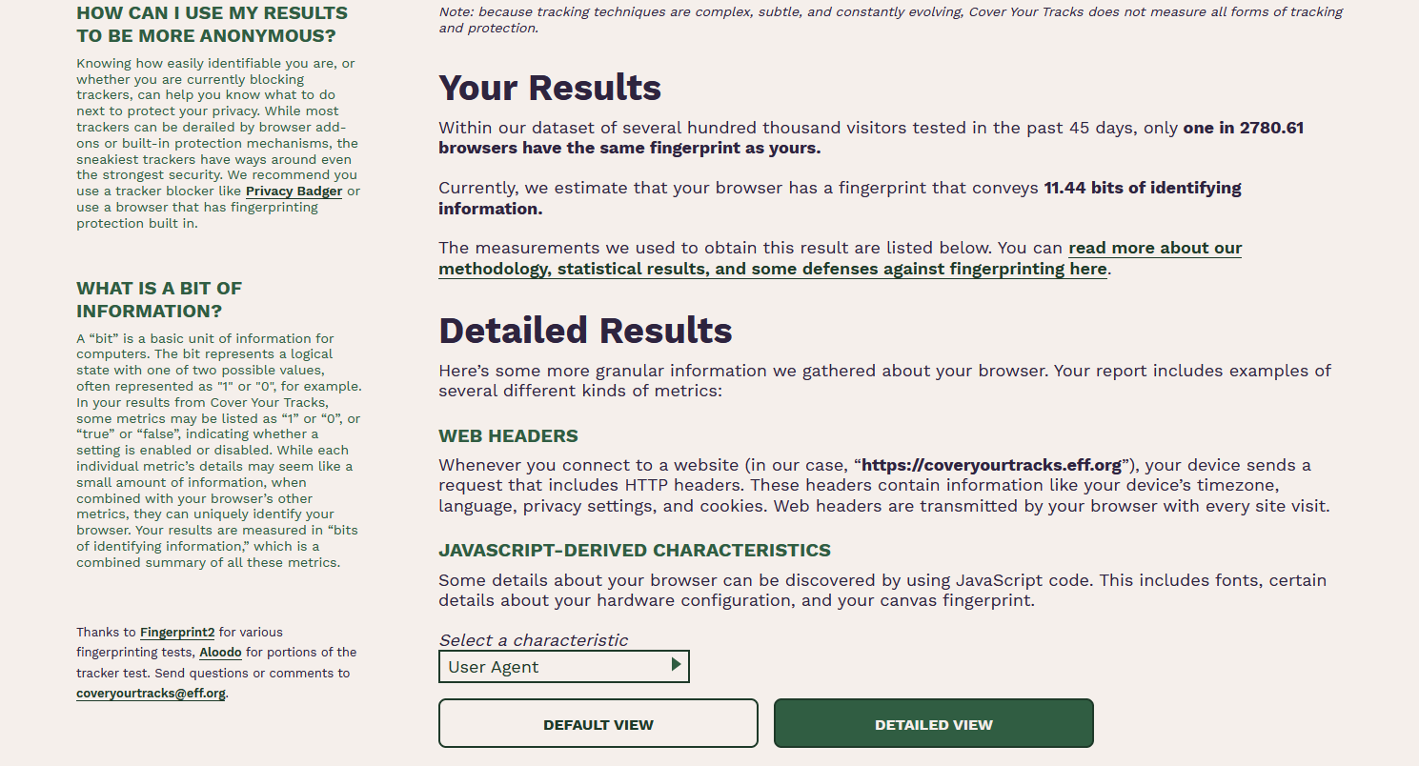

Slide 22
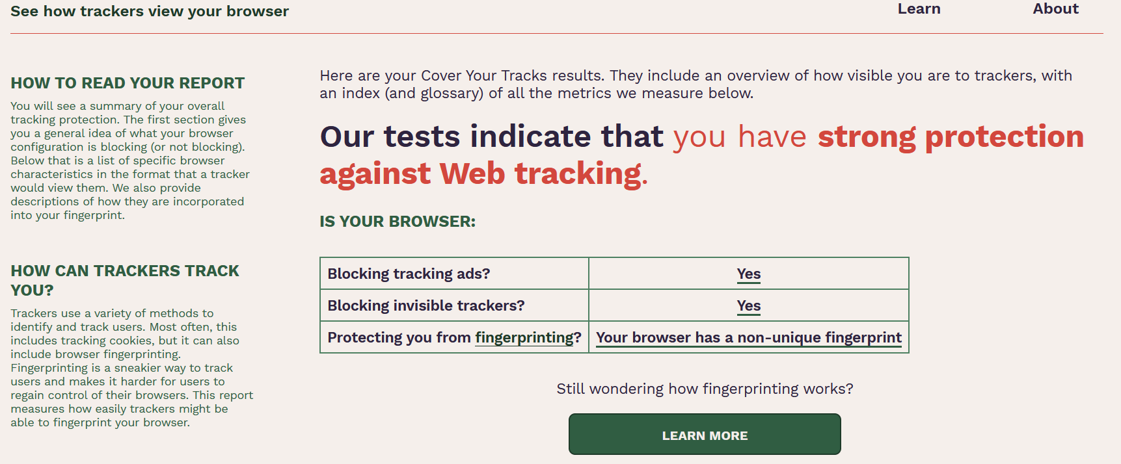
Tor Private Tabs

Slide 23
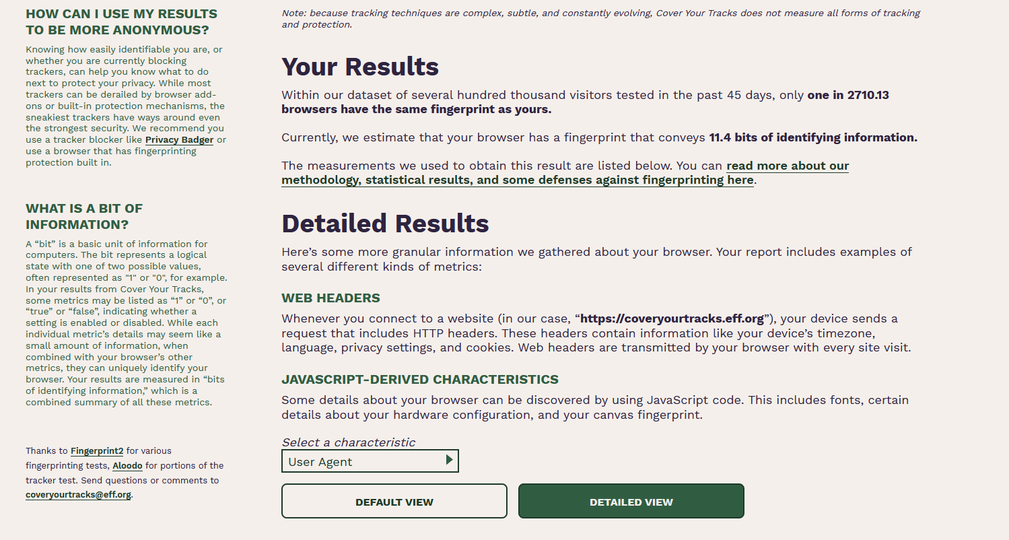

Slide 24
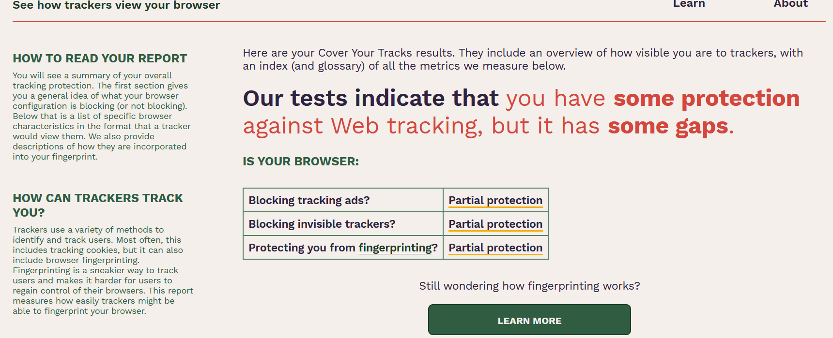
Tor with Safer Security

Slide 25
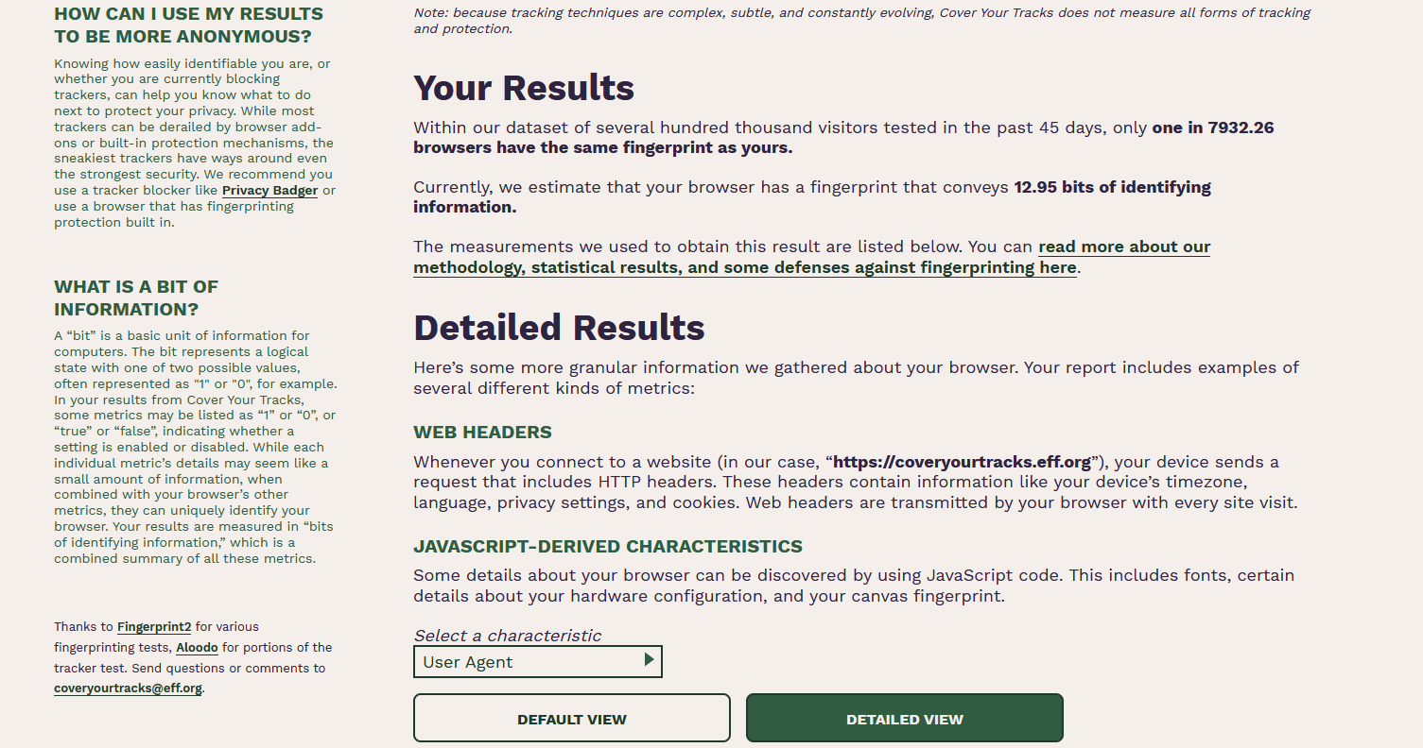

Slide 26
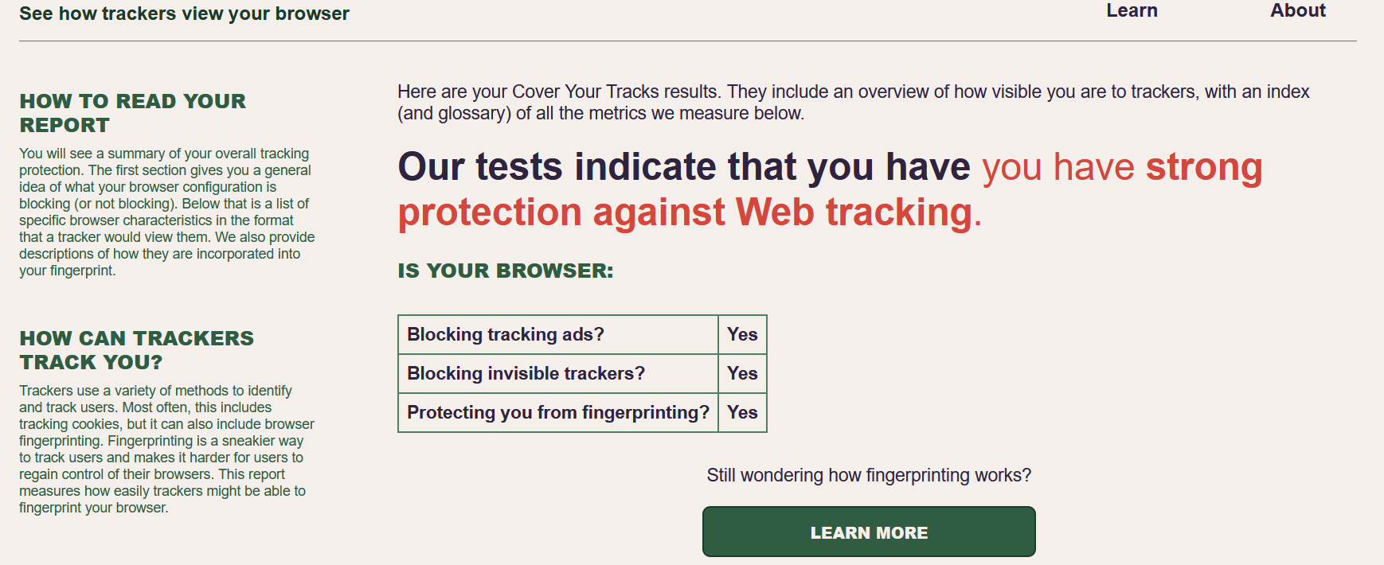
Tor with Safest Security

Slide 27
